Slide 1
MANAGEMENT OF RECEIVABLES

Slide 2
Structure
Introduction
5.2 Credit Policy
5.3 Credit Evaluation Models
5.4 Monitoring Receivables
5.5 Collecting Receivables
5.6 Strategic Issues in Receivables Management
5.7 Summary
5.8 Key Words
5.9 Self Assessment Questions
5.10 Further Readings

Slide 3
Introduction
“Buy now, pay later” philosophy is increasingly gaining importance in the way of living of the Indian Families.
In other words, consumer credit has become a major selling factor. When consumers expect credit, business units in turn expect credit form their suppliers to match their investment in credit extended to consumers.
If you ask a practicing manager why her/his firm offers credit for the purchases, the manager is likely to be perplexed.
The use of credit in the purchase of goods and services is so common that it is taken for granted. The granting of credit from one business firm to another, for purchase of goods and
services popularly known as trade credit, has been part of the business scene for several years.
Trade credit continues to be a major source of funds for firms and accounts receivables that result from granting trade credit are major investment for the firm.

Slide 4
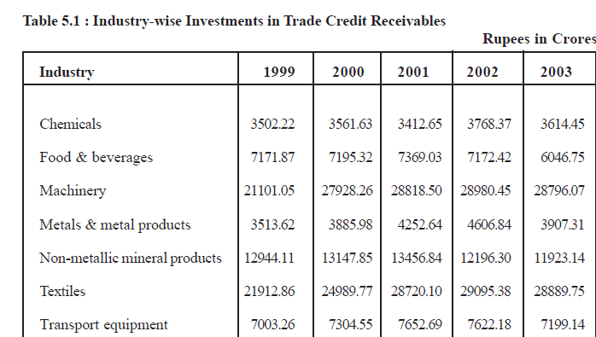

Slide 5
Major Issues in Debtors Management
Terms of credit
Assessing customers’ credit worthiness to grant credit
Monitoring the level of accounts receivables and improving collection efficiency.

Slide 6
Credit Policy
Setting of terms of credit is first step in the receivables management.
It is a corporate policy and thus has a close interrelationship with other corporate policies.
For example, if a company pursues a policy of market leadership, then it requires aggressive credit policy to achieve maximum sales volume. Terms of credit requires management to decide period of credit, a broad guideline on the eligibility of credit, credit limit for different customers and discount rate offered to customers who settles the bill within a predetermined period.
Credit policy is determined by trading off risk associated with granting credit and additional revenue available from granting credit. The credit policy once determined is fixed in the short-run and may warrant periodic adjustment depending on the changes in environment and corporate policies.

Slide 7
Credit Policy
Determining creditworthiness of customers, first, requires a system to collect basic information about the customers and then fit the data into a Model that determines the suitability of the customer in granting credit and other credit terms. Once credit is granted, the focus is shifted to collection of dues in time.
The efficiency of receivables management is measured by comparing the extent to which collection flows are in line with credit terms.

Slide 8
Credit Policy
The credit policy consists of the following components:
• Credit Period
• Discount
• Credit Eligibility
• Credit Limit

Slide 9
Credit Period
Decision on credit period is determined by several factors. It is important to check the credit period given by other firms in the industry.
It would be difficult to sustain by adopting a completely different credit policy as compared to that of industry.
For example, if the industry practice is 30 days of credit period, a firm which offers 120 days credit would certainly attract more business but the cost associated with managing longer credit period also increases simultaneously.
On the other hand, if the firm reduces the credit period to 10 days, it would certainly reduce the cost of carrying receivables but volume would also decline because
many customers would prefer other firms, which offer 30 days credit. In other words, granting trade credit is an aspect of price.

Slide 10
Credit Period
The time that the buyer gets before payment is due, is one of the dimensions of the product (like quality, service, etc.) which determine the attractiveness of the product.
Like other aspects of price, the firm’s terms of credit affect its volume.
All other things being equal, longer credit period and more liberal credit-granting policies increase sales, while shorter credit period and more stringent credit granting policies decrease sales. These policies also affect the level and timing of certain costs.
Evaluation of credit policy changes must compare with the changes in sales and additional revenues generated by the sales as a result of this policy change and costs effects. While additional volume and revenue associated with such additional volume are clear and measurable, the cost effects require further analysis.

Slide 11
Cost of Extending Credit Period
Lengthening credit period delays the cash inflows.
For example, suppose a firm increases the credit period from 30 days to 90 days. Customers, old as well as new, will now pay at the end of 90 days and the cash inflows from these sales would occur further into the future.
That means, the firm has to delay in settling its dues to others or resort to short-term borrowing if the payments cannot be delayed. The interest cost of short-term borrowing arises mainly on account of extending the credit period.

Slide 12
Example of Additional Cost
Flysafe Travels is one of the large air-ticket sellers in the city. It offers one month credit for the air-tickets booked through the firm. Since it also gets one month credit from the air-lines, the payables and receivables are by and large matched and there is no need of additional investment. The present annual turnover of the firm is around Rs.40 crores.
The firm is now contemplating to increase the credit period from one-month to two-months and this is expected to increase the volume by 40% and nearly 80% of the customers (old and new) are expected to avail the new credit facility. The firm has just concluded a credit proposal with a nationalised bank to meet payment liability at 15%. How much more it costs for Flysafe Travels to meet the increased credit volume.

Slide 13
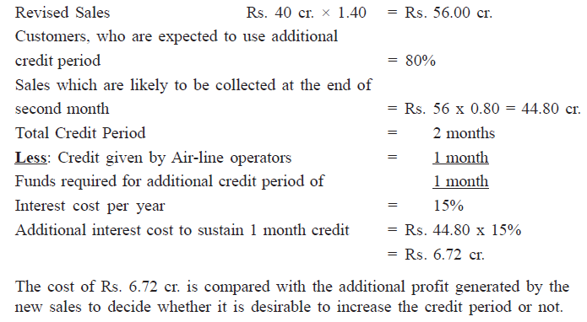
Determining Additional Cost

Slide 14
Cost of Extending Credit Period
Changes in credit period also affect the cost of carrying inventory. It arises due to increased volume by the extended credit period, which requires more inventory to support increased volume.
For example, if expected additional sales is Rs. 5 cr. and the firm’s present operating cycle requires an inventory at 20% of its sales value, the additional inventory requirement is Rs. 1 cr. Again, inventory is a idle investment and consumes cost in the form of cost of storage and cost of carrying inventory. If the two costs together amount to 17%, the changes in credit policy has caused an additional cost of Rs. 17 lakhs.
Another cost associated with extending credit term and increase in sales volume on account of extended credit term is discount and bad debts expenses.
Increase in credit sales and period would prompt firms to announce attractive discount policy for prompt payment. Similarly, bad debts will also go up due to increased volume of credit sales. Collection cost also increases.

Slide 15
Cost of Extending Credit Period
COST OF COLLECTION
Case | Sales (Rs.) | Cost of Collection (Rs.)
Present | 56 Crores | 0.56 crore
Previous | 40 Crores | 0.40 crore
Difference | 16 Crores | 0.16 crore

Slide 16
Discount
When a firm pursues aggressive credit policy, it affects cash flows in the form of delayed collection and bad debts.
Discounts are offered to the customers, who purchased the goods on credit, as an incentive to give up the credit period and pay much earlier. For example, suppose the terms of credit is “3/10 net 60”.
It means if the customer, who gets 60 days credit period can pay within 10 days from the date of purchase and get a discount of 3% on the value of order.
Since the customer uses the opportunity cost of funds and availability of cash in taking decision, the cash discount should be set attractive. The discount quantum should be greater than interest rate of short-term borrowings.

Slide 17
Discount
Excel Industries is presently offering a credit period of 60 days to some of their customers. It now intends to introduce a discount policy of “3/10 net 60”. We will now see how a customer would evaluate the discount policy here.
If a customer bought goods worth of Rs. 1 lakh, the amount due at the end of 60 days is Rs. 1 lakh and if he pays within 10 days, it costs Rs. 97,000. The customer evaluates the interest cost of Rs.97,000 for 50 days to take a decision on availing the discount and advancing the payment.
Suppose the interest cost is 15%, then cost of interest for 50 days on Rs.97,000 is Rs. 97,000 x 0.15 x (50/365), which works out to Rs. 1,993.15. Since the discount value is greater than the cost, it is profitable for the customer to pay the money earlier within 10 days and avail the discount.
In other words, if the customer borrows money for 50 days at 15% interest cost in the short-term market or bank and uses the money to settle the account within 10 days, the loan amount due at the end of two months is Rs. 98,993.15, which is lower than Rs. 1,00,000 due at the end of the period in the normal course

Slide 18
Credit Eligibility
Having designed credit period and discount rate, the next logical step is to define the customers, who are eligible for the credit terms.
The credit-granting decision is critical for the seller since credit-granting has economic value to buyers and buyers decision on purchase is directly affected by this policy

Slide 19
Credit Eligibility
For instance, if the credit eligibility terms reject a particular customer and requires the customer to make cash purchase, the customer may not buy the product from the company and may look forward to someone who is agreeable to grant credit.
Nevertheless, it may not be desirable to grant credit to all customers. It may instead analyse each potential buyer before deciding whether to grant credit or not based on the attributes of that particular buyer.
Credit period and discount rate are not changed frequently in order to maintain consistency in the policy, credit eligibility is periodically reviewed. For instance, an entry of new customer would warrant a review of credit eligibility of existing customers.

Slide 20
Credit Eligibility
The decision whether a particular customer is eligible for credit terms generally involves a detailed analysis of some of the attributes of the customer.
Credit analysts normally group the attributes in order to assess the credit worthiness of customers. One traditional way of organizing the information is by characterizing the applicant along five dimensions namely, Capital, Character, Collateral, Capacity
and Conditions. These five dimensions are also popularly called Five Cs of credit analysis.

Slide 21
Capital
The term capital here refers to financial position of the applicant firm.
It requires an analysis of financial strength and weakness of the firm in relation to other firms in the industry to assess the credit worthiness of the firm.
Financial information is normally derived from the financial statements of the firm and analyzed through ratio analysis. The liquidity ratios like current ratio, debt-service coverage ratio, etc. are often used to get a preliminary idea on the
financial strength of the firm.
Further analysis includes trend analysis and comparison with the other industry norm or other firms in the industry

Slide 22
Character
A prospective customer may have high liquidity but delay payment to their suppliers. The character thus relates to willingness to pay the debts.
Some relevant questions relating to character are:
• What is the applicant’s history of payments to the trade?
• Has the firm defaulted to other trade suppliers?
• Does the applicant’s management make a good-faith effort to honour debts as they become due?
Information on these areas are useful to assess the applicant’s character.

Slide 23
Collateral
If a debt is supported by collateral, then the debt enjoys lower risk because in the event of default, the debt holder can liquidate the collateral to recover the dues.
The collateral causes hardship to other debt holders. Thus,
the analysts should look into both the availability of collateral for the debt and the amount of collateral the firm has given to others.
In computing the liquidity of the firm, the analysts should remove the assets used for collateral and take into account only the free assets.
The credit worthiness improves if the customer is willing to offer collateral assets or the value of collateral asset backed loan is low.

Slide 24
Capacity
Capacity has two dimension - management’s capacity to run the business and applicant firm’s plant capacity.
The future of the firm depends on the management’s ability to meet the challenges. Similarly, the facility should exist to exploit the opportunity.
Since the assessment of capacity is a judgement on the part of analysts, a lot of care should be taken in assessing this feature.

Slide 25
Conditions
These are the economic conditions in the applicant’s industry and in the economy in general.
Scope for failure and default is high when the industry and economy are in contraction phase. Credit policy is required to be modified when the conditions are not favorable.
The policy changes include liberal discount for payment within a stipulated period and imposing lower credit limit.

Slide 26
Credit Limit
If a customer falls within the desired limit of credit worthiness, the next issue is fixing the credit amount. This is some thing similar to banks fixing overdraft limit for the account holders.
If a customer is new, normally the credit limit is fixed at the lowest level initially and expanded over the period based on the performance of the customer in meeting the liability.
Credit limit may undergo a change depending on the changes in the credit worthiness of the customer and changes in the performance of customer’s industry.

Slide 27
Credit Limit
There are several reasons for limiting the credit facility to the customers.
Some of the important reasons are:
Reduce the impact of deficiencies in credit-granting decision;
Reduce the scope for overbuying by the customers;
Rationally allocate the limited funds available for investment in bills receivable; and
Mitigate agency problem

Slide 28
Agency Problem
Agency problem arises on account of conflict of interest between the managers (agents) and equity shareholders (owners or principal).
Agents will always try to maximize their return even if it is at the cost of principal. Two types of agency problems arise in credit-granting decision.
Firstly, managers may collude with some of the customers and grant credit even to undesirable customers. Credit limit puts a cap on the potential loss.
Secondly, managers may hesitate to give credit to even creditworthy customers when the performance of the managers is assessed on the basis of collection efficiency.

Slide 29
Agency Problem
Recently, many public sector banks were criticized for not granting fresh loan despite comfortable monetary position and funds are simply used to buy government securities.
The fear of default and delay in collection would prevent in granting credit even to good customers and thus, take away the opportunity to maximize the profit.
Credit limit would to some extent take away this fear of managers since default is restricted and thus would encourage them to accept credit proposals. The situation will improve further if credit limits are built into the system of performance evaluation and managers are not penalized as long as they have restricted the credit.

Slide 30
MONITORING RECEIVABLES
Managing receivables does not end with granting of credit as dictated by the credit policy. It is necessary to ensure that customers make payment as per the credit term and in the event of any deviation, corrective actions are required.
There are several possible reasons for customers to deviate from the payment terms.

Slide 31
MONITORING RECEIVABLES
Three of these possible reasons and their implications in credit management are discussed below:
Changing Customer Business Characteristics
Inaccurate forecasting & defective credit policy
iii) Improper Policy Implementation : Intervention of top officials and ad hoc decisions are cited as major reasons for widespread defaults in many public financial institutions. Thus, it is necessary to ensure that policies are implemented in letter and spirit

Slide 32
Costs of Debtors
1. Cost of financing – Due to delay in realization
2. Administrative Costs : Before credit sales (Information gathering about credit worthiness etc.) . After sales (Record keeping of credit sales and collection thereof)
3. Delinquency cost (Due to delay in realization – reminder, letter, phone, legal notice etc.
4. Default cost (Bad Debt)

Slide 33
Credit Control
1. Collection Procedure
2. Monitoring of Rec.
1. Collection Procedure (Strict vs. lenient) :
Statement – Reminder – Telephone – Personal Visit – Legal Action (Last).
Collection procedure seeks to fasten the speed of slow paying customers and reduce the incidence of bad debt.

Slide 34
Monitoring of Debtors
i) Aging Analysis : The quality of AR can be known through aging analysis. The older the AR the lower the quality – greater likelihood of default and vice-versa.
In the aging analysis the total outstanding AR on a particular day (at the end of month/year) are classified into different age groups ( Age mean no. of days since becoming outstanding) together with percentage of total receivables that fall in each age group.

Slide 35
Aging Analysis
Age Group (No. of Days) | % of Total Outstanding Receivables
Less than 30 Days | 60%
31-35 Days | 20%
46-60 days | 10%
61 days & Above | 10%

Slide 36
2. Accounting Ratios
a) Debtors Turnover Ratio &
b) Average Collection Period
Debtors Turnover Ratio
DT Ratio = Net Credit Sales/Average AR
Average AR = (OD & BR+CD & BR)/2
This ratio indicates the number of times the receivables are turned over and converted into cash in an accounting period.
Higher turnover means speedy collection from debtors.
b) Average Collection Period = 365/ Debtors Turnover Ratio

Slide 37
Evaluation of Credit Policy
Class Discussion

